Slide 1

HEALIFY
Guide Name: Dr. Ankit Kumar Team Member
Vinayak ( 1900290110130)
Simran Bhardwaj (1900290110111)
Shivang Gupta (200029011004575)
Karishma (1900290210075)

Slide 2
Table of Content
Introduction
Brief Literature Survey
Problem formulation
Objective
Methodology/ Planning of work
Facilities Required for Proposed Work
Schedule of Project Completion
Conclusion
References

Slide 3
Introduction
The project is based on providing a health specific platform to share experience and knowledge regarding any health issues discussed by the users. This allows the user to increase the overall health awareness whether it is basic nutrition or any health disorder. Users can get many recommendations from other users of their likes to increase knowledge in terms of health and cure themselves. This also provides ongoing health trends such as overall health of the nation, discussion over major health issues and projecting spotlight on to important major concerns by analyzing the data over the community. This also provides health practitioners to provide their health-related services to cater their respective clients.

Slide 4
Brief Literature Survey
[1] Health Status of the Indian youth
The youth of India between 10–24-year age group constitutes a major role in growth of the nation. As per the survey nearly 30 percent of youth are not aware of their basic health and nutrition. Majority lies in malnutrition and over-nutrition. This leads to Multiple changes in human body such as Mental illness, neurological disorders and socio-economic losses. as per WHO, an estimated 2.6 million young people aged 10 to 24 year die each year and a much greater number of young people suffer from illnesses ‘behaviors’ which hinder their ability to grow and develop to their full potential. Many health policies and programmes have focused on prioritized individual health problems which failed most of the time. Sometimes citizens decides to commit suicide which is not acceptable in such age group.

Slide 5
Brief Literature Survey
[2] Nutrition and the generations
It states that the world needs the nutrition accountability. Food insecurity, hunger and malnutrition is affecting millions of the population which is unacceptable. This report conveys that we need to build infrastructure for nutrition improvement. The report clearly shows that if such infrastructure is not built by 2030 then malnutrition will take over the nation.
Western culture have replaced traditional home cooked meals with ready-to-eat, processed foods in urban Indian households [5, 6]. These changing food preferences have contributed to the increased risk of chronic degenerative diseases, thus affecting the quality of life and health of about 1.2 billion Indians [2, 6]. This highlights the need to nurture healthy eating habits among Indians from an early age.

Slide 6
Problem formulation
According to the research papers [1], [2],[3],[4] we can clearly see that almost 54 crore youth citizens of India are unaware of their health and nutrition which tends to decrease their growth rate and in long-term this might affect the growth of the nation too as youth is the important part of the country in all aspects.
On the other hand, the Indian trainers do not have enough platforms to cater their services and it seems that they are underestimated in terms of salary, respect and other things.
From the above two points we conclude that:
we need to provide a community to increase awareness among the citizens.
we need to provide a service platform for health practitioners to cater their services to a health specific community.

Slide 7
Objectives
To provide communication channel between users and citizens. Where they can discuss health specific issues.
To provide a service platform between client and health practitioners such as nutritionists, personal trainers, etc.

Slide 8
Methodology
DESIGNING WEBPAGES OF THE WEBSITE
FRONT-END + BACK-END
BACK-END + ML-INTEGRATION
COMPATIBILITY TEST OF THE WEBSITE
RESEARCH & PUBLICATION

Slide 9
Facilities Required
Wireframing tools: Balsamiq Cloud.
Front-end technologies: HTML5, CSS3, Bootstrap, JavaScript.
Back-end technologies: Node.js, ejs, express.js, react.js, tensorflow.js, MongoDB atlas.
Graphics tools: Font awesome, Color hunt.
Dataset: Google audio set, The CHiME 5.

Slide 10
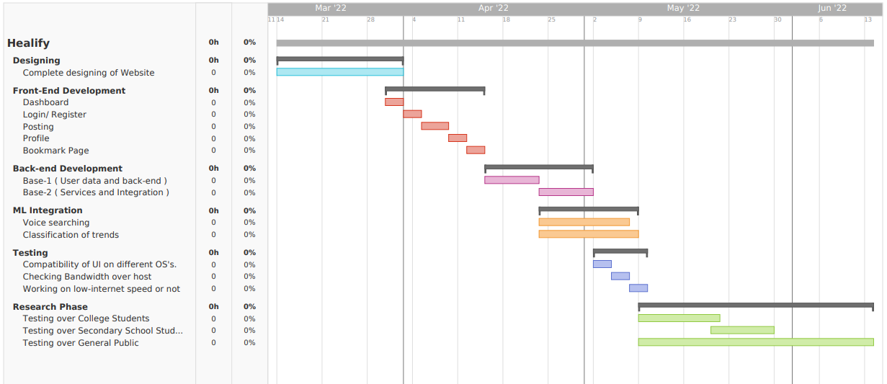
Schedule of project completion

Slide 11
Current Progress
As per the guidelines we had completed 25 % of our project by completing the designing phase of the development cycle.
Dashboard | Your First Project | healify | Balsamiq Cloud

Slide 12
Conclusion
Research paper on the impact of the community in improvement of health and nutrition.

Slide 13
References
Sunitha, S., & Gururaj, G. (2014). Health behaviours & problems among young people in India: Cause for concern & call for action. The Indian journal of medical research, 140(2), 185.
Haddad, L. J., Hawkes, C., Achadi, E., Ahuja, A., Ag Bendech, M., Bhatia, K., ... & Flores-Ayala, R. (2015). Global Nutrition Report 2015: Actions and accountability to advance nutrition and sustainable development. Intl Food Policy Res Inst.
Rathi, N., Riddell, L., & Worsley, A. (2017). Food consumption patterns of adolescents aged 14–16 years in Kolkata, India. Nutrition journal, 16(1), 1-12.
Kumar, M. M., Karpaga, P. P., Panigrahi, S. K., Raj, U., & Pathak, V. K. (2020). Impact of COVID-19 pandemic on adolescent health in India. Journal of family medicine and primary care, 9(11), 5484.

Slide 14
THANK YOU

